Slide 1
Transformer Model:
Most competitive neural sequence transduction models have an encoder-decoder structure [5, 2, 35]. Here, the encoder maps an input sequence of symbol representations (x1, ..., xn) to a sequence of continuous representations z = (z1, ..., zn). Given z, the decoder then generates an output sequence (y1, ..., ym) of symbols one element at a time. At each step the model is auto-regressive, consuming the previously generated symbols as additional input when generating the next.
The Transformer follows this overall architecture using stacked self-attention and point-wise, fully connected layers for both the encoder and decoder.

Slide 2

Time Window – 6 Resampling – 10

Slide 3
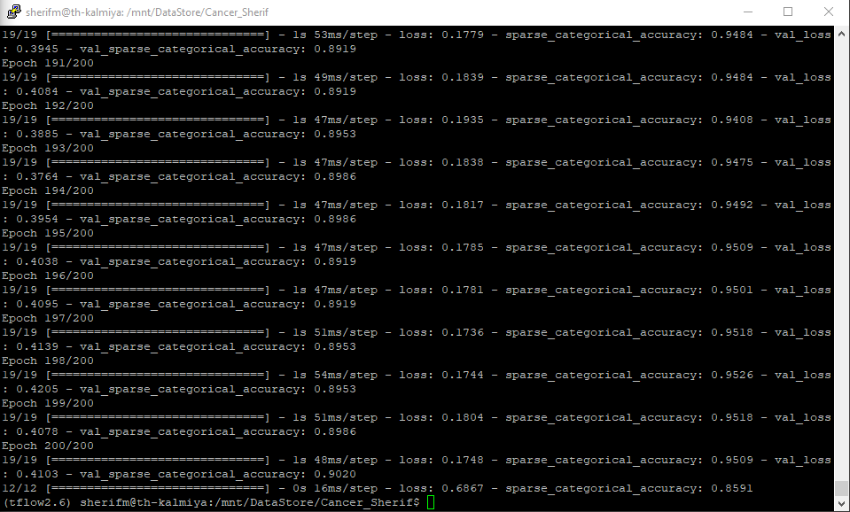
Initial Result
Folder - 0
Head_size = 256,
Num_heads = 256,
Ff_dim = 4,
num_transformer_blocks = 4,
Mlp_units = [128],
Mlp_dropouts = 0.4,
Dropout = 0.25
Loss = 0.41
Accuracy = 0.90

Slide 4
Optimized Result
Folder - 0:
Head_size = 128,
Num_heads = 4,
Ff_dim = 4,
num_transformer_blocks = 6,
Mlp_units = [128],
Mlp_dropouts = 0.4,
Dropout = 0.25
Loss = 0.33
Accuracy = 0.91

Slide 5
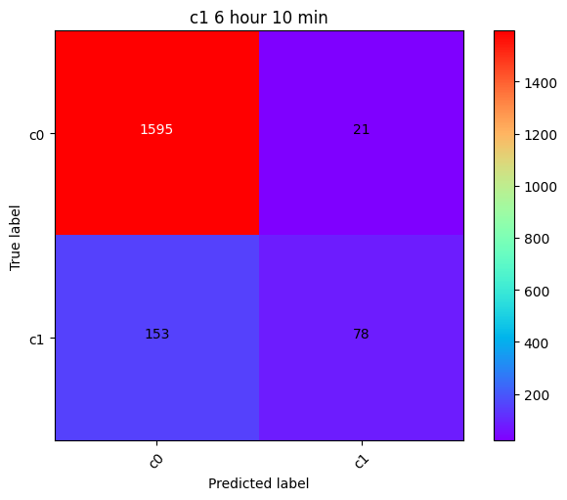
Channel Initial Result
Channel_First
Head_size = 256,
Num_heads = 256,
Ff_dim = 4,
num_transformer_blocks = 4,
Mlp_units = [128],
Mlp_dropouts = 0.4,
Dropout = 0.25
Loss = 0.32
Accuracy = 0.90

Slide 6

Channel optimized Result
Channel_last
Head_size = 256,
Num_heads = 256,
Ff_dim = 4,
num_transformer_blocks = 4,
Mlp_units = [128],
Mlp_dropouts = 0.4,
Dropout = 0.25
Loss = 0.31
Accuracy = 0.90

Slide 7
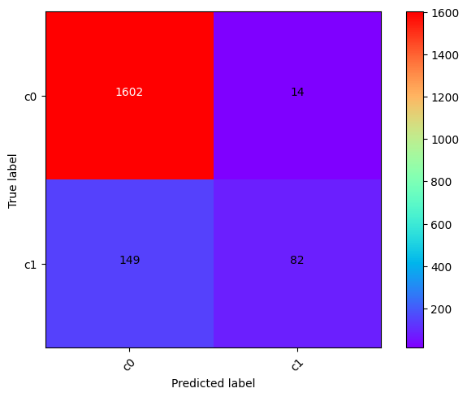
Channel optimized Result
Channel_first + channel_last
Head_size = 256,
Num_heads = 256,
Ff_dim = 4,
num_transformer_blocks = 4,
Mlp_units = [128],
Mlp_dropouts = 0.4,
Dropout = 0.25
Loss = 0.30
Accuracy = 0.91

Slide 8
Model | Val_Loss | Val-Accuracy
Folder0 | 0.33 | 0.91
Folder1 | 0.32 | 0.91
Folder2 | 0.31 | 0.91
Folder3 | 0.33 | 0.90
Folder4 | 0.32 | 0.91
Channel not Optimized
Model | Val_Loss | Val-Accuracy
Folder0 | 0.30 | 0.91
Folder1 | 0.30 | 0.92
Folder2 | 0.31 | 0.91
Folder3 | 0.31 | 0.91
Folder4 | 0.27 | 0.92
Channel Optimized

Slide 9
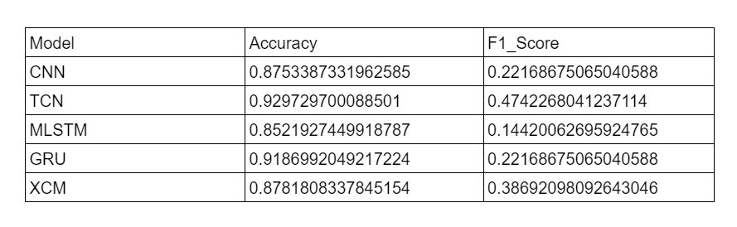
Result Obtained by DSM team:

Slide 10
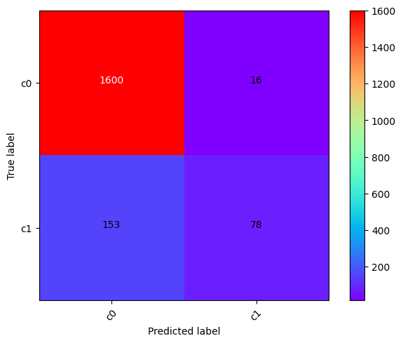
Without Additional Dropout
With Additional Dropout

Slide 11
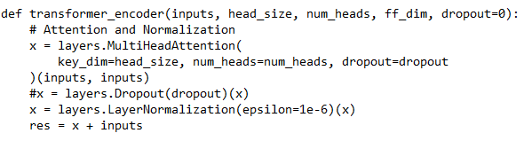
Folders | Val_Loss | Val-Accuracy
Folder0 | 0.31 | 0.91
Folder1 | 0.31 | 0.92
Folder2 | 0.31 | 0.90
Folder3 | 0.29 | 0.91
Folder4 | 0.27 | 0.91
Without Additional Dropout
Folders | Val_Loss | Val-Accuracy
Folder0 | 0.30 | 0.91
Folder1 | 0.30 | 0.92
Folder2 | 0.31 | 0.91
Folder3 | 0.31 | 0.91
Folder4 | 0.27 | 0.92
With Additional Dropout

Slide 12
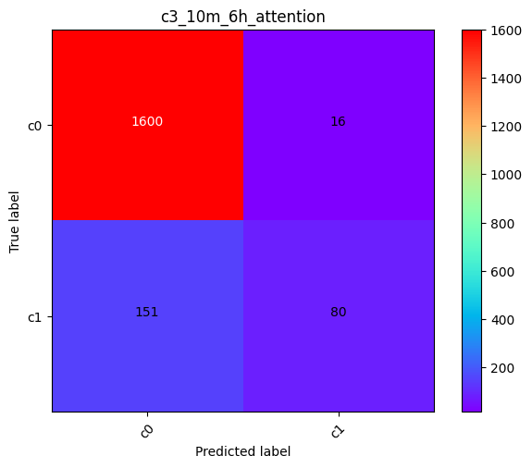
Overall Channel optimized Result with return attention:
With Additional Dropout
for _ in range(num_transformer_blocks): print('block’, _ ) if _ != 1 and _ != 6: x = transformer_encoder(x, head_size, num_heads, ff_dim, dropout, return_attention=False) else: x, attn = transformer_encoder(x, head_size, num_heads, ff_dim, dropout, return_attention=True) z = inputs for _ in range(num_transformer_blocks): if _ != 1 and _ != 6: z = transformer_encoder(z, head_size, num_heads, ff_dim, dropout, return_attention=False) else: z, attn = transformer_encoder(x, head_size, num_heads, ff_dim, dropout, return_attention=True)
Loss = 0.31
Accuracy = 0.90

Slide 13
Time Window -6, Concatenated channel results with block 1 & 6 = True return attention
Model | Val_Loss | Val-Accuracy
Folder0 | 0.30 | 0.91
Folder1 | 0.30 | 0.91
Folder2 | 0.33 | 0.90
Folder3 | 0.30 | 0.91
Folder4 | 0.29 | 0.91

Slide 14
Time Window – 7 Resampling -10

Slide 15

Channel Initial Result
Overall Result of Every Folders
Head_size = 256,
Num_heads = 256,
Ff_dim = 4,
num_transformer_blocks = 4,
Mlp_units = [128],
Mlp_dropouts = 0.4,
Dropout = 0.25
Channel_First
Loss = 0.34
Accuracy = 0.90

Slide 16

Channel optimized Result
Overall Result of Every Folders
Channel_last
Head_size = 256,
Num_heads = 256,
Ff_dim = 4,
num_transformer_blocks = 4,
Mlp_units = [128],
Mlp_dropouts = 0.4,
Dropout = 0.25
Loss = 0.35
Accuracy = 0.90

Slide 17

Channel optimized Result
Overall Result of Every Folders
Channel_first + channel_last
Head_size = 256,
Num_heads = 256,
Ff_dim = 4,
num_transformer_blocks = 4,
Mlp_units = [128],
Mlp_dropouts = 0.4,
Dropout = 0.25
Loss = 0.32
Accuracy = 0.90

Slide 18
Time Window -7, Concatenated channel results
Model | Val_Loss | Val-Accuracy
Folder0 | 0.32 | 0.89
Folder1 | 0.34 | 0.90
Folder2 | 0.31 | 0.90
Folder3 | 0.29 | 0.92
Folder4 | 0.33 | 0.90

Slide 19
Time Window – 12 Resampling -10

Slide 20
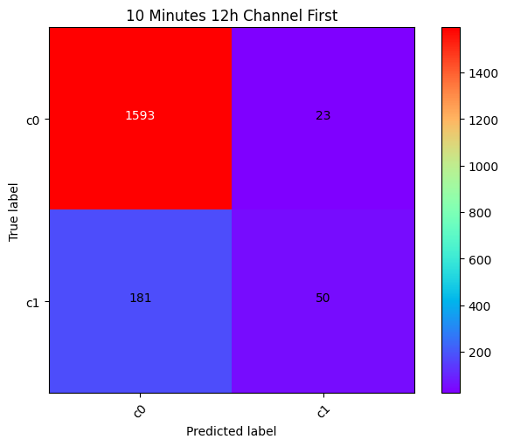
Channel Initial Result
Overall Result of Every Folders
Head_size = 256,
Num_heads = 256,
Ff_dim = 4,
num_transformer_blocks = 4,
Mlp_units = [128],
Mlp_dropouts = 0.4,
Dropout = 0.25
Channel_First
Loss = 0.40
Accuracy = 0.88

Slide 21

Channel optimized Result
Overall Result of Every Folders
Channel_last
Head_size = 256,
Num_heads = 256,
Ff_dim = 4,
num_transformer_blocks = 4,
Mlp_units = [128],
Mlp_dropouts = 0.4,
Dropout = 0.25
Loss = 0.40
Accuracy = 0.89

Slide 22

Channel optimized Result
Overall Result of Every Folders
Channel_first + channel_last
Head_size = 256,
Num_heads = 256,
Ff_dim = 4,
num_transformer_blocks = 4,
Mlp_units = [128],
Mlp_dropouts = 0.4,
Dropout = 0.25
Loss = 0.37
Accuracy = 0.89

Slide 23
Time Window -7, Concatenated channel results
Model | Val_Loss | Val-Accuracy
Folder0 | 0.33 | 0.90
Folder1 | 0.36 | 0.90
Folder2 | 0.37 | 0.91
Folder3 | 0.40 | 0.90
Folder4 | 0.41 | 0.89

Slide 24
Time Window – 5 Resampling -12

Slide 25

Channel Initial Result
Overall Result of Every Folders
Head_size = 256,
Num_heads = 256,
Ff_dim = 4,
num_transformer_blocks = 4,
Mlp_units = [128],
Mlp_dropouts = 0.4,
Dropout = 0.25
Channel_First
Loss = 0.39
Accuracy = 0.89

Slide 26

Channel optimized Result
Overall Result of Every Folders
Channel_last
Head_size = 256,
Num_heads = 256,
Ff_dim = 4,
num_transformer_blocks = 4,
Mlp_units = [128],
Mlp_dropouts = 0.4,
Dropout = 0.25
Loss = 0.39
Accuracy = 0.89

Slide 27

Channel optimized Result
Overall Result of Every Folders
Channel_first + channel_last
Head_size = 256,
Num_heads = 256,
Ff_dim = 4,
num_transformer_blocks = 4,
Mlp_units = [128],
Mlp_dropouts = 0.4,
Dropout = 0.25
Loss = 0.42
Accuracy = 0.89

Slide 28
Time Window -5, Concatenated channel results
Model | Val_Loss | Val-Accuracy
Folder0 | 0.44 | 0.91
Folder1 | 0.36 | 0.89
Folder2 | 0.53 | 0.89
Folder3 | 0.34 | 0.90
Folder4 | 0.43 | 0.89

